Slide 1
Deep Learning - II
Swakkhar Shatabda

Slide 2
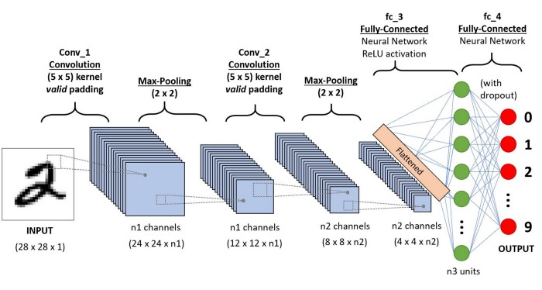
Convolutional Neural Nets
Each neuron receives some inputs, performs a dot product and
optionally follows it with a non-linearity

Slide 3
Convolutional Neural Network (ConvNet/CNN)
The pre-processing required in a ConvNet is much lower as compared to other classification algorithms.
In primitive methods, filters are hand-engineered, with enough training, ConvNets have the ability to learn these filters/characteristics.
Analogous to that of the connectivity pattern of Neurons in the Human Brain and was inspired by the organization of the Visual Cortex.

Slide 4
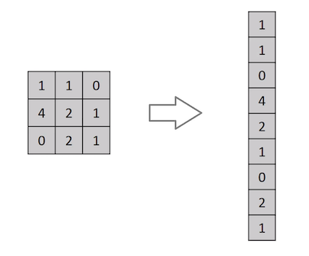
ConvNets vs Feed-Forward Neural Nets?
A ConvNet is able to successfully capture the Spatial and Temporal dependencies in an image through the application of relevant filters.
The architecture performs a better fitting to the image dataset due to the reduction in the number of parameters involved and reusability of weights.
Flattening of a 3x3 image matrix into a 9x1 vector
For example, an image of more respectable size,
e.g. 200x200x3, would lead to neurons that have
200*200*3 = 120,000 weights.

Slide 5
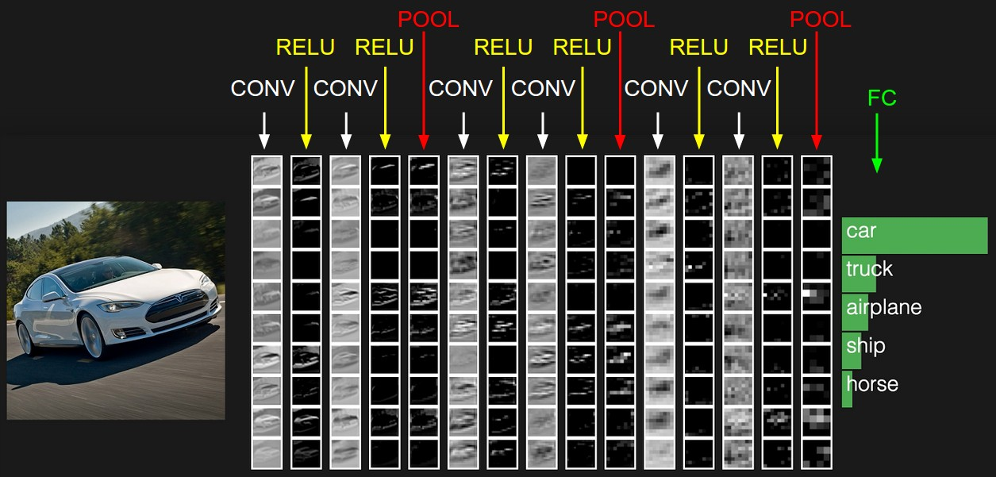
ConvNet
Three types of layers:
Convolutional
Pooling
Fully Connected

Slide 6
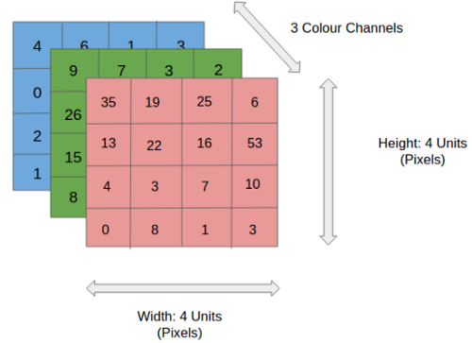
Input Image
The role of the ConvNet is to reduce the images into a form which is easier to process, without losing features which are critical for getting a good prediction
4x4x3 RGB Image

Slide 7
Convolution Layer — The Kernel
Image Dimensions = 5 (Height) x 5 (Breadth) x 1 (Number of channels, eg. RGB)
Kernel/Filter, K, represented in the color yellow. We have selected K as a 3x3x1 matrix.
Kernel/Filter, K =
1 0 1 0 1 0 1 0 1

Slide 8
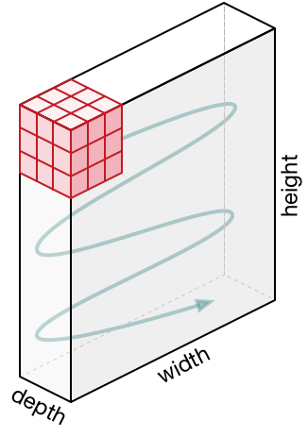
Movement of the kernel
The Kernel shifts 9 times because of Stride Length = 1 (Non-Strided), every time performing a matrix multiplication operation between K and the portion P of the image over which the kernel is hovering.

Slide 9
Multi-Channel

Slide 10
Convnet
Conventionally, the first ConvLayer is responsible for capturing the Low-Level features such as edges, color, gradient orientation, etc. With added layers, the architecture adapts to the High-Level features

Slide 11
Padding
There are two types of results to the operation — one in which the convolved feature is reduced in dimensionality as compared to the input, and the other in which the dimensionality is either increased or remains the same.
Valid Padding
Same Padding

Slide 12
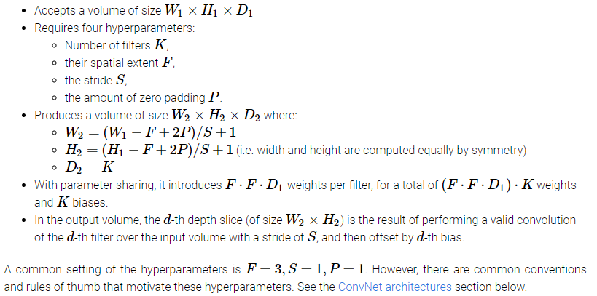
Output size

Slide 13
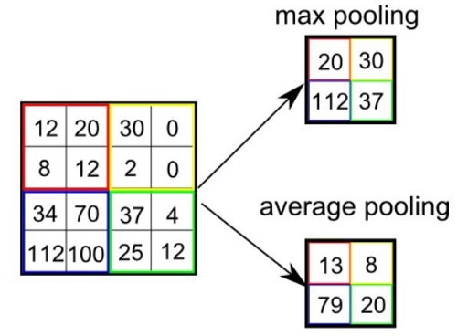
Pooling Layer
Pooling layer is responsible for reducing the spatial size of the Convolved Feature.
There are two types of Pooling: Max Pooling and Average Pooling.
Max Pooling also performs as a Noise Suppressant.

Slide 14
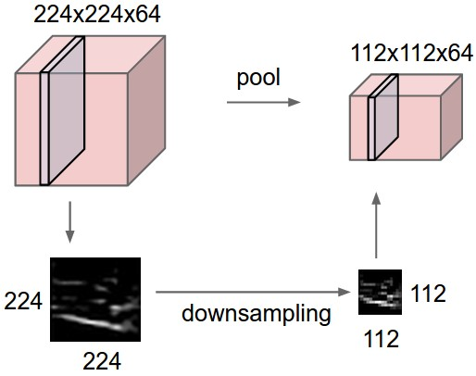
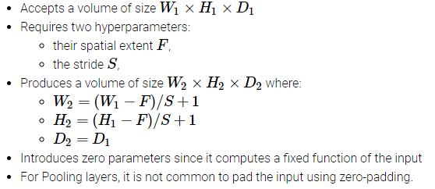
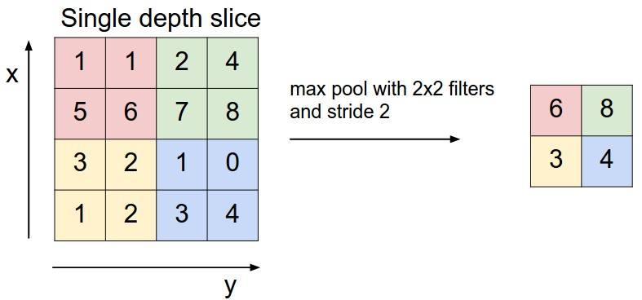
POOLING

Slide 15
Network Parameters
Consider a convolutional layer which takes “l” feature maps as the input and has “k” feature maps as output. The filter size is “n*m”.
Here the input has l=32 feature maps as inputs, k=64 feature maps as outputs and filter size is n=3 and m=3. It is important to understand, that we don’t simply have a 3*3 filter, but actually, we have 3*3*32 filter, as our input has 32 dimensions. And as an output from first conv layer, we learn 64 different 3*3*32 filters which total weights is “n*m*k*l”. Then there is a term called bias for each feature map. So, the total number of parameters are “(n*m*l+1)*k”.

Slide 16
Data Augmentation
Translation
Random Crops
Rotation
Horizontal Flips
180 degree
Scaling
Injecting noise

Slide 17
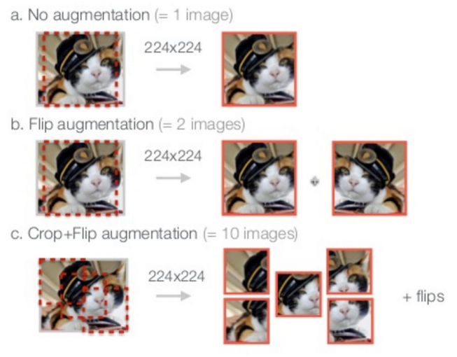
Data Augmentation
Use principal components

Slide 18
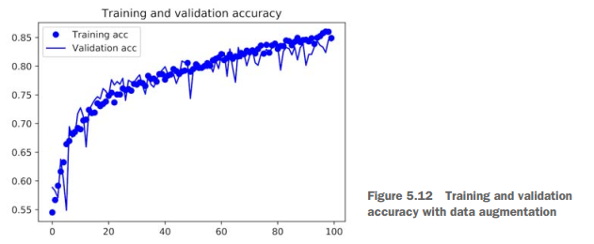
Data Augmentation
www.kaggle .com/c/dogs-vs-cats/data

